Slide 1
NCSAB: Proactive Methods for Using Data to Track and Improve VR Outcomes
Michigan Bureau of Services
for Blind Persons
Bill Robinson, Director
Lisa Kisiel, Field Services Division Director
Wednesday October 31, 2018
2:45-4:30pm Session 1

Slide 2
Why Data is Important? What is measured can be managed.
Metrics
A Metric is a quantifiable measure that is used to track and assess the status of a specific business process. Examples:
60 Day Eligibility (Case Mgmt. System Dashboard)
90 Day IPE (Case Mgmt. System Dashboard)

Slide 3
Why Data is Important? What is measured can be managed
Performance Indicator evaluates the effectiveness or success of the organization’s programs. Examples:
Employment Rate  2nd Quarter After Exit
Employment Rate  4th Quarter After Exit

Slide 4
Data Driven Planning & Management
Pre-Employment Transition Services
Forecasting
Collaboration with LEAs (Example included)
Workforce Collaboration
Staffing/Resource Allocation - (Example included)
Case Services
911 Data – RSA Reports (Example included)
Data Analytics – Action Alerts, Dashboards, etc.
Financial Data
Grant Mgmt; Projections (OOS); DSA & Public updates

Slide 5
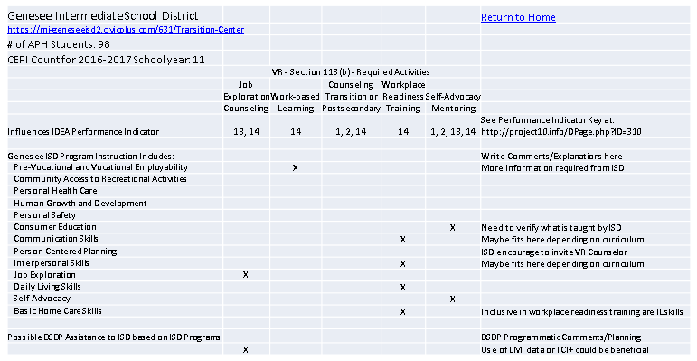
Pre-ETS Collaboration with LEAs - Strategic planning and resource development

Slide 6
Workforce Collaboration
Infrastructure Funding Agreements – “Active Participants”
Accessibility
Tracking In-Kind Contributions
Tracking In-Service
Tracking Contacts
Toolkit for Counselors

Slide 7
Staffing/Resource Allocation – Counselor X – No. of Clients – 68

Slide 8
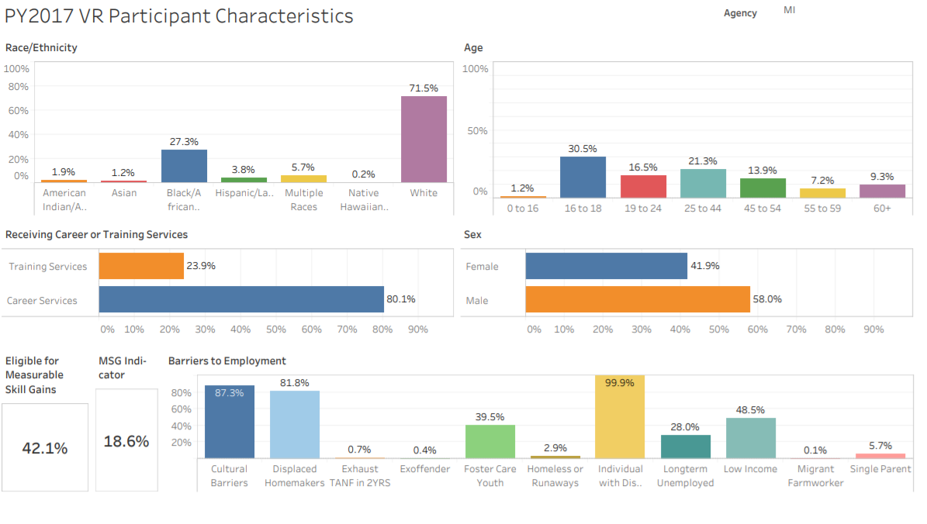
PY2017 VR Participant Characteristics

Slide 9
WIOA PERFORMANCE DRIVEN!
Video sound is only of vehicles racing.

Slide 10
LARA/BSBP – 2018 NCSAB FALL CONFERENCE
Thank you!
Questions?
Contact information:
RobinsonW7@Michigan.gov
kisiell@michigan.gov
The Vocational Rehabilitation programs described in this PowerPoint are funded 78.7% through a VR grant from the U.S. Department of Education and 21.3% through State funding. Total Federal funding for Federal Fiscal Year 2018 was approximately $16,630,804.

